Slide 1
International Seminar on National Hydrology Project: Towards a Reliable Data Acquisition for IWRM
Pune, 7-8 November 2016
WR2012 system - Water information management system for South Africa, Lesotho and Swaziland
Credits: South Africa National Department of Water & Sanitation, SA Water Research Commission, Bill Pitman, Allan Bailey, Marieke de Groen

Slide 2
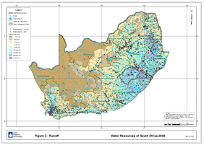
DEVELOPMENT OF A WATER INFORMATION MANAGEMENT SYSTEM FOR SOUTH AFRICA, LESOTHO AND SWAZILAND (1952 to 2015)
Notes:
The first part of this presentation looks at the progress made with each study over the last 60 or so years

Slide 3

Notes:
1,22 million km2 plus 0,05 million km2

Slide 4
Why do water resources surveys?
To provide a basis for preliminary planning of water resources development - Information can help considerably in selection of most viable schemes
To make available, in a single set of documents or website, valuable data and information for water resources planning and development
To provide information for research in other water-related disciplines e.g. water quality, ecology, agriculture and flood hydrology
Notes:
Information not at a level for final design but can help considerably in selection of most viable schemes.
Used in development of LHWP including major dams Katse, Mohale, Pulihali
Although they lead into IWRM, they don’t really get into integrating economics and social development

Slide 5
Previous water resources appraisals
1952 study by DC Midgley (first comprehensive water resources survey)
1969 survey by HRU at Wits University
1981 survey by HRU at Wits University
WR90 survey by SSI, SRK and WLPU (funded by WRC)
WR2005 survey by SSI, SRK and Knight Piesold, assisted by Arcus Gibb, Ninham Shand, PD Naidoo and Umfula Wempilo (funded by WRC)
Notes:
The WRC assisted in the 1981 funding

Slide 6
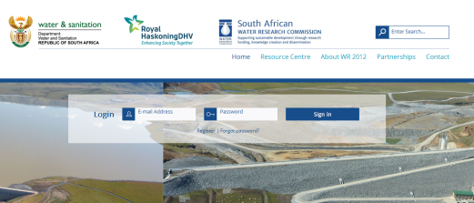
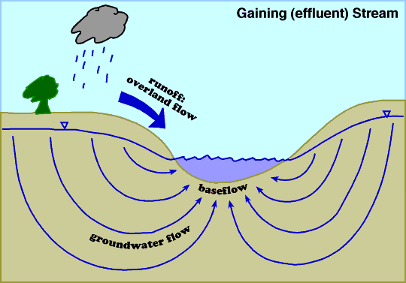
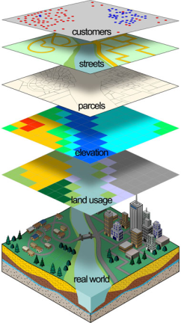
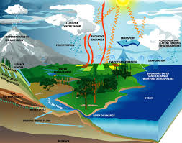
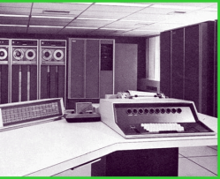
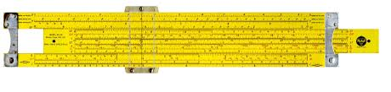
WR2012
WR2005
WR90
1981
1969
1952
Notes:
Progressed from a slide rule to a website in 60 years

Slide 7
Growth in computing power since 1969
Notes:
The growth in computer power is based on Moore’s Law, which states that computer power doubles every 2 years – the horizontal lines represent a ten-fold increase in power. Note that the 1952 study was done before the computer era.

Slide 8

Milestones
1969 survey
Application of digital computer
Subdivision into quaternary catchments
Reliability of reservoir yield
1981 survey
Application of Pitman model for simulation of streamflow time series back to 1920 (from rainfall records)
Impacts of land use taken into account, i.e. irrigation, afforestation and water transfers
Notes:
These milestones represent only the most significant advances achieved in each study. The Pitman model became the standard for future water resources studies, especially where reservoir yield is important (combine with WRYM and WRPM)
Quaternary catchments are hydrological units within Water Management Areas (WMAs) that are hierarchically nested from the primary drainage basin, through to secondary, tertiary and quaternary level. They are on average about 650 km2 in size (Nel et al. 2011a). https://www4.dwaf.gov.za/wma/

Slide 9
Water Management Areas in SA
Notes:
WMAs developed since the WR90 study set the tone for subsequent studies

Slide 10
Milestones (contd.)
WR90 survey
WRSM90 modular version of Pitman to enable use of streamflow records heavily impacted by land use
Redefinition of 1962 quaternary catchment boundaries to conform with DWS numbering system, achieved with the aid of GIS
Move from main frame to personal computer
Notes:
The WR90 study set the tone for subsequent studies WR2005 and WR2012 – quaternary catchments defined in WR90 have become the standard for subsequent water resources studies.

Slide 11
Milestones (contd.)
WR2005
Move from DOS to Windows with increased power and flexibility
Incorporation of D.A. Hughes and K. Sami algorithms to model surface-groundwater interaction
Modelling of alien veg. impacts and improved modelling of afforestation, irrigation and wetlands
Incorporation of Mining Module
Analysis of water quality parameters
Notes:
The first “integrated water resources” study to model surface/groundwater interaction and include water quality aspectsWRSM2000/Pitman model
Built on WRSM2000/Pitman model

Slide 12
Milestones (contd.)
WR2012
Installation of Web Site http://waterresourceswr2012.co.za/ so users can easily access results as they become available
Daily time step option in WRSM2000/Pitman in runoff modules to simulate daily streamflow (natural and with land use included)
Simulation of present-day streamflow (as compared to natural) at 84 key points throughout the study area
Notes:
The present day development analysis was carried out for the first time. This means that the time series of rainfall as from 1920 to 2010, was used to generate flows as they would have been under present day development. This gives important information as to the effect of land use/water use on the study area and as to the functioning of current developments under different hydrological conditions. Eighty-four key points throughout the study area have been analysed in detail;

Slide 13
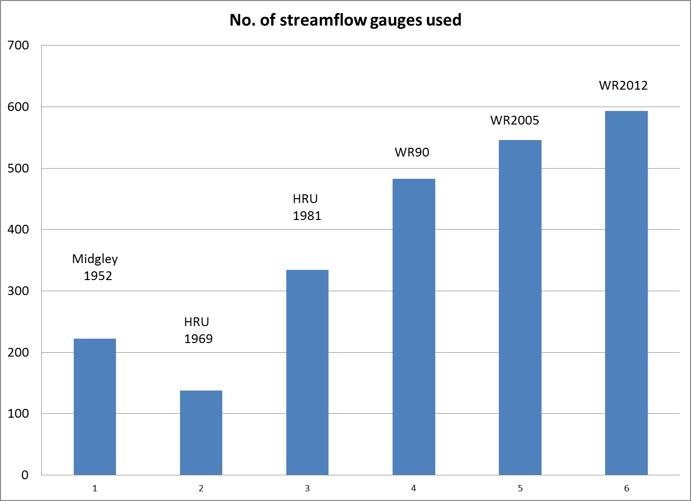
No. of streamflow gauges used per study
Notes:
Drop in 1969 due to elimination of records affected by land-use and the need for longish records to establish reservoir yield/reliability relationships. Of the nearly 600 gauges used in WR2012, only about 400 are still open.

Slide 14
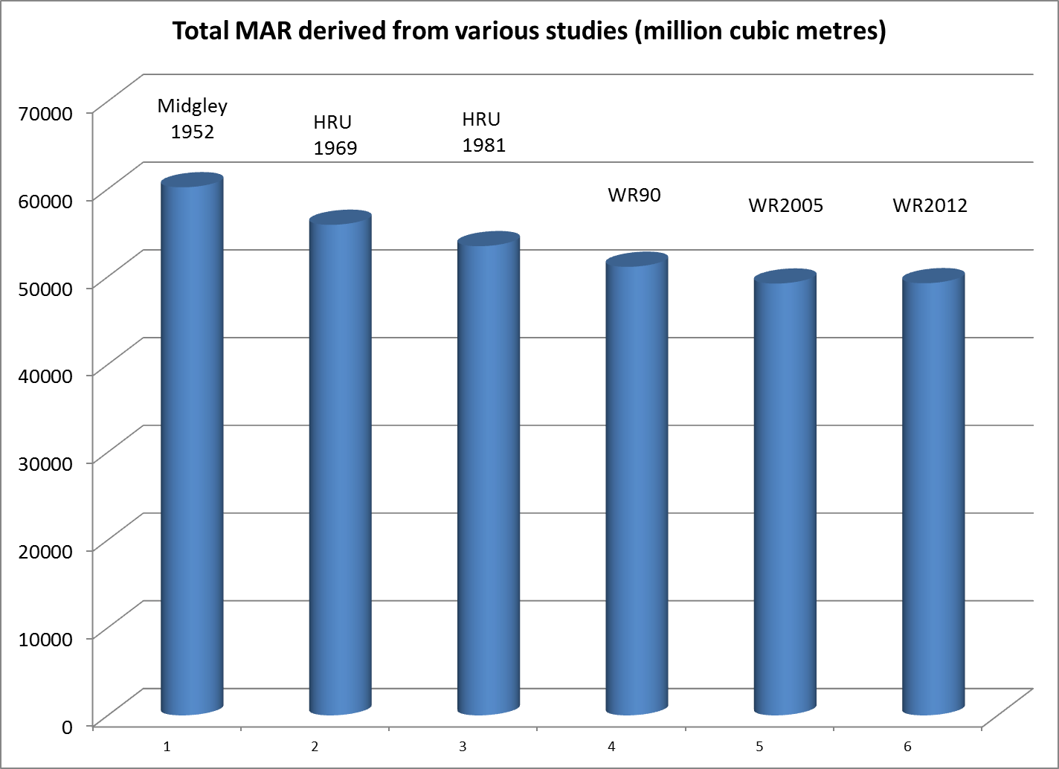
Total MAR derived from various studies
Notes:
This refers to naturalised mean annual runoff.
The decline in estimated MAR has now come to an end, with that for WR2005 and WR2012 being almost identical (despite recalibration and improvements in land-use data in some areas). Decreasing trend probably due to improvements in flow gauging, eg replacing daily readings with autographic gauges.

Slide 15
Are these Appraisals worthwhile ?
An economic study of the WR90 project some 10 years ago produced the following main findings :
Having WR90 information meant that time for water resources studies was cut by a factor of 5 on average and
The net present value of the study was ZAR27,8 million (₹12 crore) compared to a study cost of ZAR5,7 million (₹2,5 crore)
Notes:
Benefit : Cost ratio of about 5

Slide 16
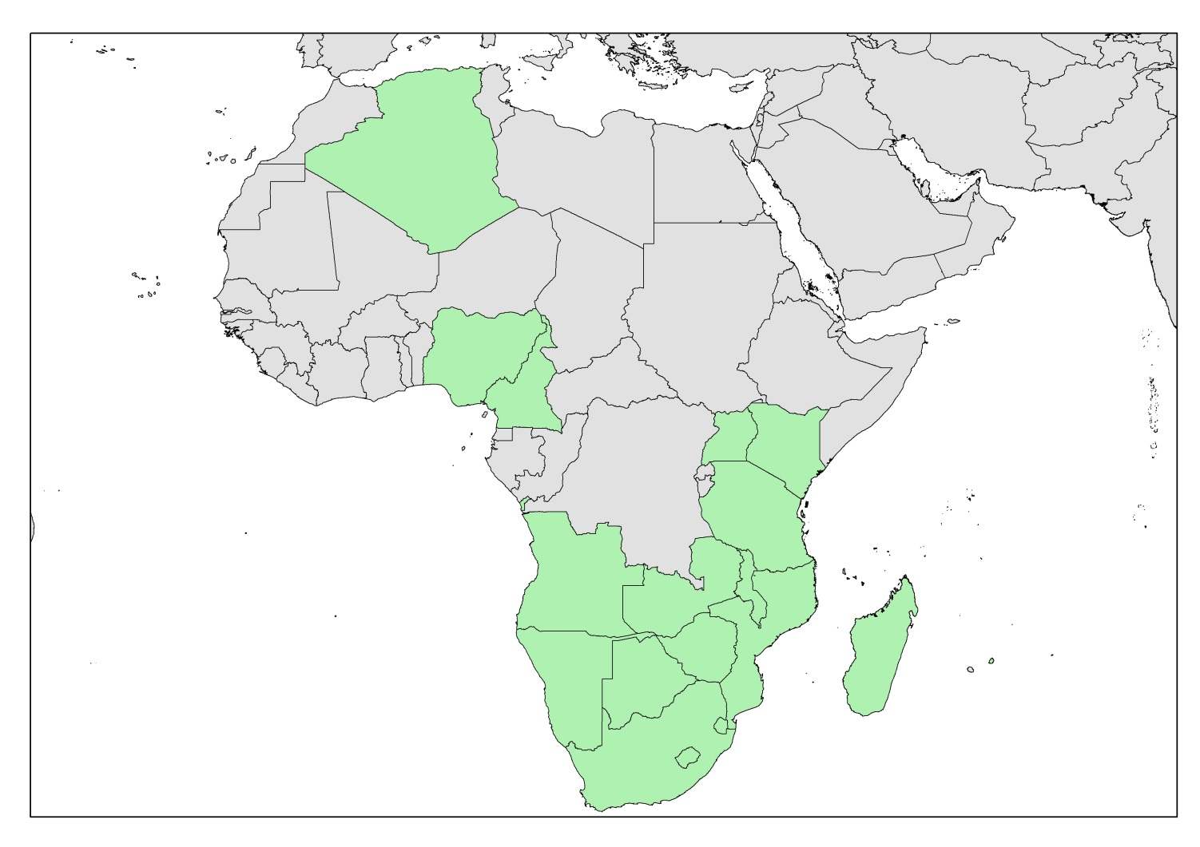
African countries in which WRSM2000/Pitman model used
Notes:
Mention Mauritius

Slide 17
Some concerns for future appraisals
While computing power is growing exponentially (doubles every 2 years) and methodologies and analytical computing tools are improving, there are serious concerns about the decline in monitoring of the following important variables:
Rainfall
Streamflow
Reservoir water balances
Abstractions and Effluent discharges
Water quality and
Water transfers
Notes:
Unlimited computer power and sophisticated models are useless without a good set of data on all important hydrological variables.
Representivity of the measuring sites is also a key factor

Slide 18
Some exciting new possibilities for future appraisals
  New data tools such as rainfall and streamflow data apps for smart phones
  Appraisals for other Southern African countries/catchments
Notes:
Other Southern African appraisals have been considered and taken quite far in discussion but have not materialised due to funding and ownership issues

Slide 19

Thank you!
Credits:
South Africa National Department of Water & Sanitation, SA Water Research Commission, Water Management Professionals Allan Bailey, Marieke de Groen
Notes:
Other Southern African appraisals have been considered and taken quite far in discussion but have not materialised due to funding and ownership issues

